Slide 1




Tunisian HTA Experience
The National Instance
for Accreditation in Health Care - Tunisia
Dr.Héla GRATI
Dr.Wafa ALLOUCHE
Istanbul, 28th November 2015

Slide 2
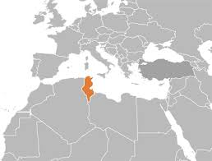
Tunisian Health Care System ₍₁₎
  Tunisia has faced many challenges since its independence including health domain.
  Healthcare system has been developed and managed to significantly improve the population health indicators.

Slide 3
Tunisian Health Care System ₍₂₎
  Tunisia is actually facing not only a demographic, socio-economic and epidemiological transitions but also an important progress of medicine.
  Health care system requires more support to provide appropriate and efficient response to the needs of the population.
Notes:
However….
so….

Slide 4
The National Instance for Accreditation
in Health Care ₍₁₎
  The country has started a strategy to improve the quality of care by establishing a national agency for HTA and accreditation in health care.
  Our National Instance for Accreditation in Health Care (INASanté) is the second agency in EMRO region ( WHO Regional Office for the Eastern Mediterranean) and also in the African continent.

Slide 5

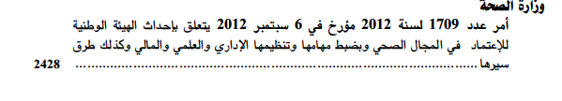
The National Instance for Accreditation
in Health Care ₍₂₎
  INASanté was created by decree the 6th september 2012.
Notes:
Here you can see a decree copy from a Tunisian law

Slide 6
The National Instance for Accreditation
in Health Care ₍₃₎
INASanté
Accreditation
HTA
Notes:
INASanté has two departements: The accreditation and the health technology assessment departement.

Slide 7

Legal form
INASanté is :
      Public
      Independent
      Non-Administrative
      Scientific Authority

Slide 8
INASanté Values
Our values :
      Scientific Rigor
      Trans-disciplinarity
      Independence
      Impartiality
      Transparence
      Efficiency
Notes:
Our values in INASAnté are

Slide 9
INASanté Missions
  Health Technology Assessment
  Accreditation of public and private health institutions
  Information of professionals and citizens
Notes:
The INASanté aims to improve every link in the care chain by:
Espacially by elaborating reports assessing technologies

Slide 10

HTA in INASanté
  HTA aims to provide evidence to decision makers for a better health resources allocation .
CHALLENGE
Notes:
Establishing an effective HTA program is a challenging task for the national health care system.

Slide 11

HTA building steps
1
Solid commitement from politicians.
2
Establishment of an organisational structure.
3
Funds (Governemental , WHO and EU contributions).
4
5
6
Gathering multidisciplinary HTA team, building capacities.
Engaging stakeholders with different objectives, resources and operational capacities.
Joining International Networks.
Notes:
WHO and EU contributions are the mean ressource of funds

Slide 12

Engaging stakeholders
  Stakeholders’ analysis has aimed to :
      Greater understanding, acceptance and participation of all stakeholders.
      Enhancing capacities to carry out HTA mission.
Notes:
Stakeholders engagements is very important, we have launched a project on this purpose

Slide 13
Project stages
  Two stages :
      Stakeholders’ interviews in order to develop HTA strategy (April 2015).
      Consensus meeting to resolve issues organized as a workshop seminar (May 2015).
Notes:
In april 2015 we organized meetings with all stakeholders in order to have their point of view concerning the strategy of develepoment of HTA in Tunisia.
Then we organized a workshop seminar in May 2015 to gather recommandations from different stakeholders

Slide 14

Meeting workshops
  HTA and universal health coverage.
  HTA processes and stakeholders collaboration modalities.
  Problems and solutions in implementing HTA in Tunisia.
  INASanté organization modalities.
  HTA and drugs.
Notes:
Five workshops were conducted:
5
Each workshop discussion was based on some questions related to each topic.

Slide 15

Recommendations ₍₁₎
  Health care expenditures streamlining strategy
  Supporting financement decisions
  HTA as a step for universal health coverge
Notes:
The recommendations deducted were:

Slide 16
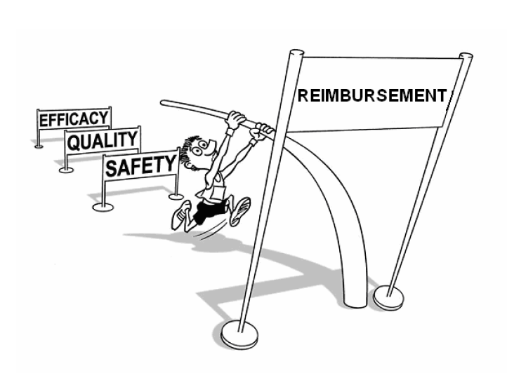
Recommendations ₍₂₎
  Perfoming scientific independant and transparent technologies assessement.
  Collaborating with international skilled experts.
  Health products reimbursement step.
Notes:
Intervening in Health products reimbursement step

Slide 17

HTA Networking ₍₁₎
INASanté is a member of :
      INAHTA
      HTAi
      HTAsia Link
      EMRO HTA Network
Notes:
Our HTA team worked Hardly to join various HTA Networks
EMRO: The WHO Regional Office for Eastern Mediterranean

Slide 18

HTA Networking ₍₂₎
INASanté is participating in this Forum in order to :
      Discover other HTA experiences
      Join the Eurasian HTA

Slide 19
Current projects
  Developing a report elaboration or adaptation process
  ➔ WHO Funding
  PACS: Competitiveness Support Project Service
  ➔ European Union Funding
Notes:
Currently, we are focusing on two projects

Slide 20

PACS project ₍₁₎
  Strengthening medico economic assessment activities in health technologies and health care interventions .
Notes:
The aim of this project is to …

Slide 21
PACS project ₍₂₎
Expected outcomes :
    Set up medico-economic assessment methodologies and tools
    Prioritization process
    Achieve economic evaluation studies and disseminate results
    Manage project research Data using informatic solutions

Slide 22

Success keys
Success will be depending on :
    The quality and relevance of the HTA reports.
    The efficency of information system.
    The willingness of the policy level to integrate HTA into the decision making.
Notes:
We now that success will not be easy and will be depending on …

Slide 23



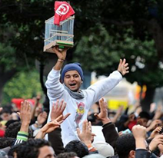


Notes:
I finish my presentation with some photos related to Tunisian Sping
We love Tunisia, Welcome to tunisia

Slide 24
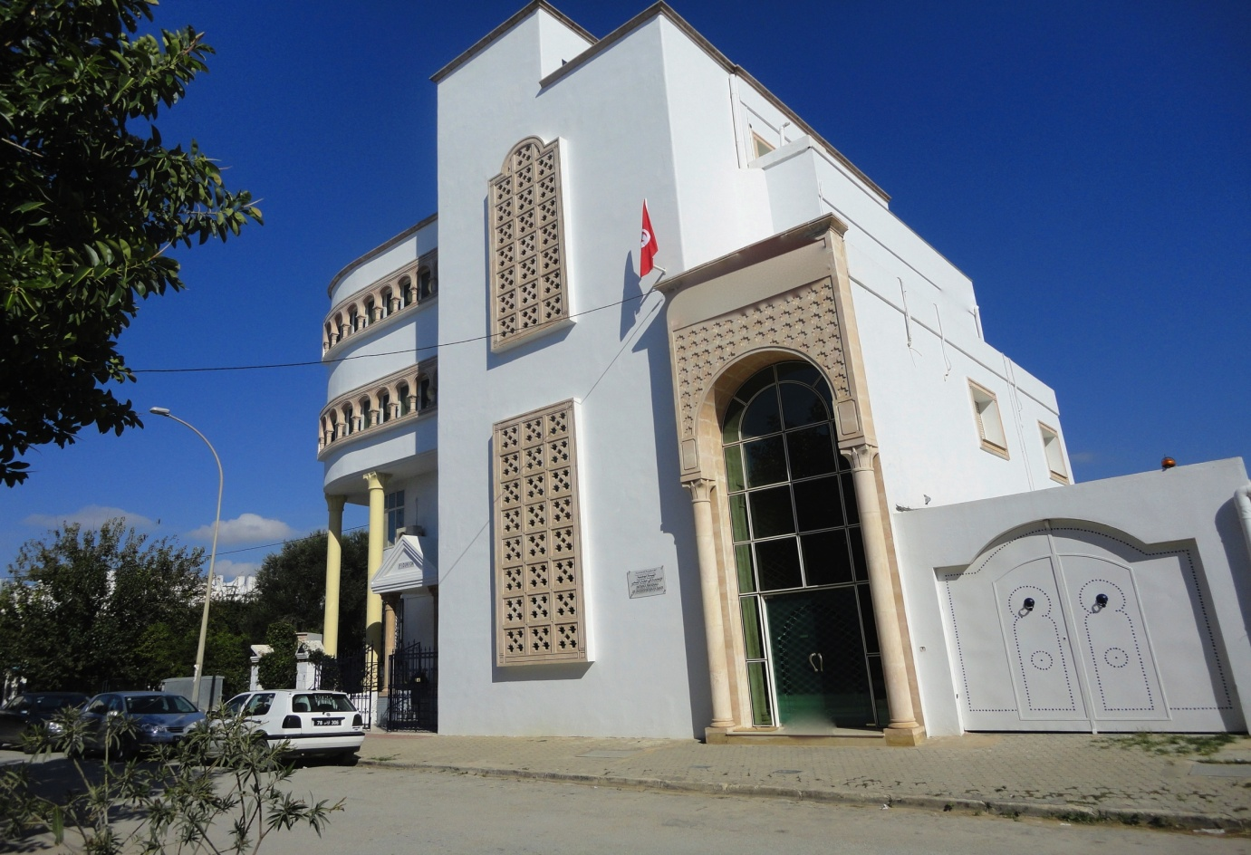
THANK YOU
http://www.inasante.tn/

