Slide 1


Institutionalization of Health Reform in Kyrgyzstan as base for developing HTA initiatives
Bermet Baryktabasova
Baktygul Kambaralieva
EBM specialists in MOH, Kyrgyzstan
Notes:
Health reform ongoing in the Kyrgyz Republic since 1996 was aimed at:
- structural changes
-introduction of progressive financing methods
-health care quality improvement

Slide 2
Key national reforms priorities in the country
In 1992, the Health reform began implementation in Kyrgyzstan health system
There are four main components of the health reform model:
Health delivery system restructuring and strengthening primary health care,
Population involvement,
New provider payment systems,
New management information systems.
Legal and policy framework, and public awareness are elements of each of these components.
Notes:
Kyrgyzstan has taken major steps toward institutionalizing health reform at the
national level and enhancing sustainability in the long-term. Kyrgyzstan along with all
Former Soviet Union countries faces enormous hurdles in restructuring the health sector to
provide lower cost, higher quality health services to the population.
Kyrgyzstan’s step-by-step approach has allowed the country to keep moving forward in health reform, identifying and removing each hurdle along the way. The job is not finished and there are many important obstacles which still need to be addressed, some of which are discussed in “Next Steps to implementation in Kyrgyz Health care principles of EBM and HTA”.
The active Health Care reform” Den Sooluk” 2012-2016 is currently being developed by an MOH working group in which reproductive, maternal and child health care, CVD, HIV, TB will be a priority issues.
One of the reasons for the success of health reform in Kyrgyzstan is the development and
implementation of a comprehensive, integrated health reform model that addresses the
problems of the health sector. While operational strategies and plans have varied with the
rapidly changing environment, the basic health reform model has remained the same. It has
provided stability in an uncertain environment and guided the path of reform. There are
four main components of the health reform model: 1) Health delivery system restructuring
and strengthening primary health care, 2) Population involvement, 3) New provider
payment systems, and 4) New management information systems. Legal and policy
framework, and public awareness are elements of each of these components.
Kyrgyzstan continues to move forward implementing all the components of the health
reform model.

Slide 3
Institutionalization of Health Reform at the National Level
A process-oriented approach was established at the national level to develop the policy and legal framework for health reform
  National FGP regulations,
  Health Insurance Fund organization and provider payment regulations,
  Medical Commission of licensing and accreditation
  Regulations for health information systems,
  Important government decree…
Notes:
A process-oriented approach was established at the national level to develop the policy
and legal framework for health reform and a step-by-step approach to implementation. A
MOH and HIF Joint Working Group was established to develop health policy, strategies,
and operational plans. Technical Joint Working Groups were also established to address
issues such as clinical information, provider payment, pharmaceuticals, and quality
assurance. The Joint Working Group process was very successful in developing a health
policy framework.
Work began to establish a legal framework based on the health policies developed by the
MOH and HIF Joint Working Group. Many pieces of the legal framework have been put in
place over the last few years. For example, national FGP regulations, Health Insurance
Fund organization and provider payment regulations, regulations for health information
systems, and important government decrees such as reinvestment of savings in the health
sector have been approved.
However, much more work is needed, particularly in the areas
of allocation of budget funds, continued restructuring of the health sector, and clinical practice.

Slide 4
Existing mechanisms to assure quality of care at all levels of health care system
Quality management in health organizations level
Medicinal & Control Commission, Drug Committees and quality Committees
Health services continuous quality improvement system
Quality management in health care system
Quality control and expertise
Medical Accreditation Committee
Health staff encouraging improvement mechanisms
Notes:
Medicinal and Control Commission (MCC) controls quality of treatment and diagnostic process. With the aim to realize the concept on rational use of drugs as well as to strengthen control over rational use of medical supplies and medical goods, the Ministry of Health of the KR has issued an order on “Drug Committee of health care facilities”.
Since 2009 continuous quality improvement system (CQIS) has been implemented in Kyrgyzstan. CQIS is a management approach that tends to ensure quality health care and effective use of the existing resources. It is implemented as a consecutive stage after the training and, in essence, this process represents monitoring and evaluation of the training effectiveness at the practical level.
For the purpose to improve health services quality management methods, control over rational and effective use of funds of mandatory health insurance (MHI) in 2002 the MOH KR adopted an order #297 by approving the Regulation on “Health care quality management in mandatory health insurance system” as per which health care quality management was determined as a complex of measures based on monitoring and analysis of indicators of health services providers activities and population health indicators. This complex of measures consists of quality expertise of health care, monitoring, analysis and evaluation of findings.
Health care quality expertise is conducted by physicians/experts of Mandatory Health Insurance Fund and its Territorial Departments by controlling of medical cards of in-patient and out-patient patient (in FGP, FMC) and their compliance to clinical protocols. Hospital, FGP/FMC activities indicators, succession indicators are used for monitoring. Analysis and evaluation of health services for the population are made based on monitoring results.

Slide 5
Quality of care at all levels of health care system & EBM
Development of clinical guidelines/ protocols based on evidence-based medicine.
Health staff retraining
Drug accessibility improvement
Notes:
In 2006 the Ministry of Health of the KR adopted EBM development strategy that aimed at creating a sustainable system of development, implementation and monitoring of clinical guidelines and protocols (CG/CP) and further promotion of EBM principles into health care and education systems of Kyrgyzstan
Measures on quality reconstruction and undergraduate and postgraduate education systems, revision of curricula in accordance to reforms realized in health care system have become a key element of health services quality improvement.
One of the components of quality health care is patients access to basic, effective drugs. For this purpose beneficial drug supply programs (Mandatory Health Insurance Additional Program, State Benefit Package) have been developed and implemented in the primary health care level. This has served as an additional mechanism on encouraging of patients visits to these organizations.

Slide 6
Legal Documents/Ministerial Orders:
The Strategy for the development of evidence-based medicine in Kyrgyz Republic for 2006 and 2010. Order of Ministry of Health № 490 04.09.06.
The organizing Structure of the process of developing EBM clinical guidelines. Order of Ministry of Health №162 01.04.08
The Methodology for the development of clinical guidelines, evidence-based medicine. Order of Ministry of Health №253 30.05.08
The position of the Council of Experts of the Ministry of Health to assess the quality of the clinical guidelines and protocols . Order of Ministry of Health № 220 26.04.10
Calendar plan of Ministry of health for the development of clinical guidelines and protocols. Order of Ministry of Health №282 28.05.10
The training programs "Principles of evidence-based medicine and CPGs/CPs development " for researchers, graduate students and applicants.

Slide 7
Current situation and key ongoing initiatives regarding the development of EBM clinical guidelines
Development of CG/CP based on evidence-based medicine principles for all levels (with quality indicators: MoH, professional associations; tertiary institutions; EBM Center
Implementation: training based on guidelines and integration into medical (undergraduate) education and residency;
Quality improvement processes for implementation of guidelines: Outpatient/inpatient level; management level (inter-sectoral including laboratory and pharmaceutical services);encouraging via remuneration depending on work quality (MHIF);

Slide 8
The key results EBM in KG
There is a clear definition of clinical guidelines and clinical protocols in MOH;
The standardized process for the development of clinical guidelines exists.
A structured and coordinated guideline programme designed with the specific aim of producing clinical guidelines
The guidelines develop with a purpose to improve quality of care, contain costs;
Criteria for selecting and deciding on the priority topics
The training courses for the methodology of developing clinical guidelines
Patients, public or their representative associations were involved in the development of the guidelines
Guidelines developed were accompanied by a patient information
The AGREE instrument used for appraising the quality of the guideline
Procedure for the revision of a published guideline
Financial incentives are used to help implementation of the clinical guidelines
The term “clinical audit” is formally defined in a document
Notes:
The key results of the survey on current situation of guidelines and protocols development and implementation at country level

Slide 9
Standardized process of developing EBM CPs/CPGs
Choice of topic
Shaping of working multidisciplinary group;
Searching for existing clinical protocol and assessment their quality;
Additional searching evidence;
Critical assessment and summary review evidence;
Formulation of recommendations and drawing up a text of clinical protocol;
Consultations and external expertise and reviewing;
Approbation of clinical protocol;
Approval by the ministry of health;
Publication and distribution:
Adoption
Revising and update.

Slide 10
Challenges & barriers
Existing standards and clinical procedures are not all based on evidence (old) and absence guidelines on national language ;
No wide spread practice of advocacy in promotion and introduction of the principles of evidence-based medicine into the clinical practice.
Insufficient financing of the health system in development of CPGs/CPs
Majority of medical personnel does not speak/read English
Most health organizations, especially in the regions, have no PC or have restricted access to PC and Internet

Slide 11
Challenges & barriers
Quality issues are not incorporated into the current financing mechanisms:
Lack of monitoring implementation of CG/CP
Measures on quality management are fragmented and incomplete
Absence cost effectiveness analysis influence of development CG/CP
Absence health technology assessment
Absence of clinical audit
Informational system does not reflect all quality issues
Control to information support of medical and pharmaceutical workers ( hyper diagnostics and promotion pharm company medicines).

Slide 12
Stakeholders for quality of care assurance & EBM
MoH (Government)
Mandatory Health Insurance Fund for quality management via financial instrument
Medical Accreditation Committee
Tertiary institutions/hospitals
Republican Medical Information Center (RMIC)
Professional associations&NGO: Kyrgyz Family planning Association, Kyrgyz Hospital’s Association
Pharm industry
Massmedia
Notes:
The Ministry of Health, determining policy and general health services quality improvement strategy;
Tertiary institutions – development of clinical guidelines and protocols, methodic manuals and recommendations on various urgent health and sanitary problems of health care system (with EBMU methodic support);
Accreditation management, for regulation of the capacity and capabilities of various health organizations in quality health services delivery

Slide 13
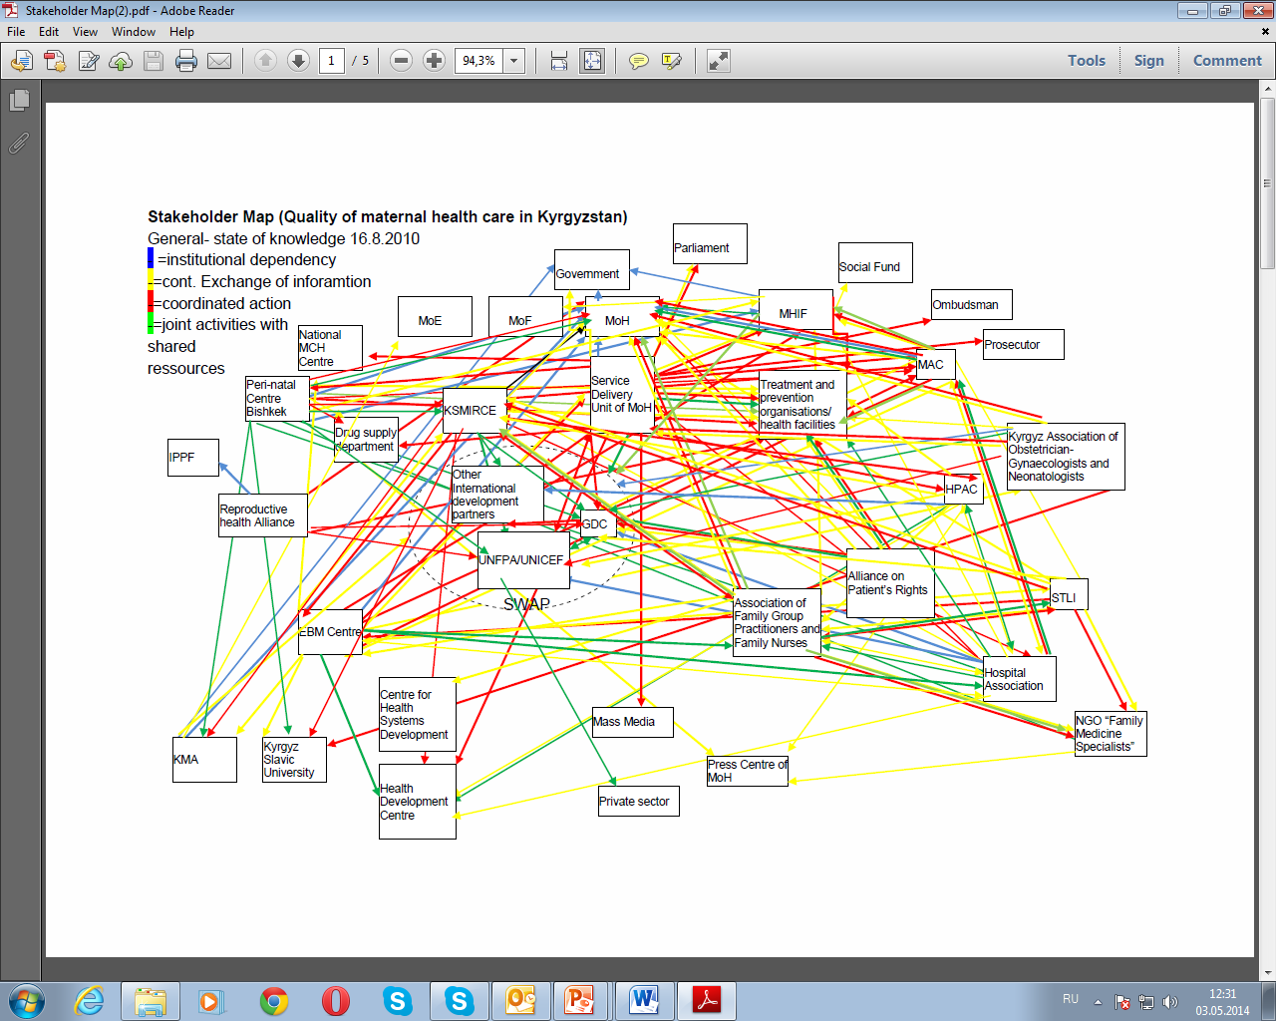

Slide 14
Partnership for quality of care assurance & EBM
The MOH in Kyrgyzstan has been successful in coordinating and integrating contributions from a multitude of donors including
World Bank
WHO
DFID (UK)
KFW (Germany)
GIZ (Germany)
Swiss Development Agency
Asian Development Bank e.t..
Many of ZdravReform’s (USAID) Central Asia program strategies have been developed and tested in Kyrgyzstan…
Notes:
The MOH in Kyrgyzstan has been successful in coordinating and integrating contributions from a multitude of donors including USAID, the World Bank, WHO, the British Know, How Fund, GIZ, the Swiss Development Agency, and the Asian Development Bank e.t..
Many of ZdravReform’s (USAID) Central Asia program strategies have been developed and tested in Kyrgyzstan, including criteria for a successful demonstration project and the demonstration widening or roll-out process; collaboration with the World Bank; the contribution of health reform to economic restructuring and democratic transition; development of a successful regional program; and integration of infectious diseases and reproductive health into primary health care to increase sustainability and health sector efficiency. In addition, Kyrgyzstan has contributed many “lessons learned” which inform and improve the health reform process throughout the Former Soviet Union.

Slide 15
Role of Kyrgyzstan as a Regional Health Reform Partner
The role of Kyrgyzstan in triggering health reform in other Central Asian countries should not be underestimated.
The countries of Central Asia still face the same problems in their
health sectors.
They look to each other for new interventions and also to learn from
experiences and avoid mistakes.
Countries including Russia, Ukraine, Mongolia, Tajikistan, Kazakhstan, Uzbekistan, and Turkmenistan have sent representatives for site visits of the Kyrgyz reforms.
Tajikistan in particular has been influenced by the health reforms in Kyrgyzstan.
The Central Asian countries are requesting more regional seminars

Slide 16
International Society of Pharmacoeconomics and Outcomes Research Kyrgyzstan Chapter was developed in 2015y.

Slide 17
The mission of the ISPOR Kyrgyzstan Chapter
1. Build, develop, and ensure Regional Chapter membership representation from health care researchers, health care practitioners, and decision-makers interested in pharm economics and outcomes research can share knowledge at a country level or regional level.
2. Serve as a bridge in bringing together country researchers, health care practitioners, and decision-makers interested in Health Technology Assessment and pharm economics, as well as members of the pharmaceutical medical device/ diagnostics industry, health-related organizations, and academia.
3. Act as a resource at a local level for individuals interested in pharm economics and outcomes research, and its use in health care decisions, clinical and economic assessment, pharma economics and outcomes research and its use in health care decisions.
4. Provide an opportunity for country or region -specific chapter members to become more familiar with the activities of ISPOR area as well as participate in its activities.

Slide 18

Kyrgyzstan
main messages – EVERYTHING IS POSSIBLE
Quality Improvement in Kyrgyzstan through use EBM/HTA is feasible: a lot has been already achieved and have to do
All support the necessity to introduce necessary changes
Results based management shoes the way («learn through practice»)

Slide 19


