Slide 1
Evidence informed decision-making and HTA
Ahmed Novo MD, Ph.D
Agency for Healthcare Quality and Accreditation in Federation of Bosnia and Herzegovina (AKAZ)
Istanbul, Turkey, November 2015

Slide 2
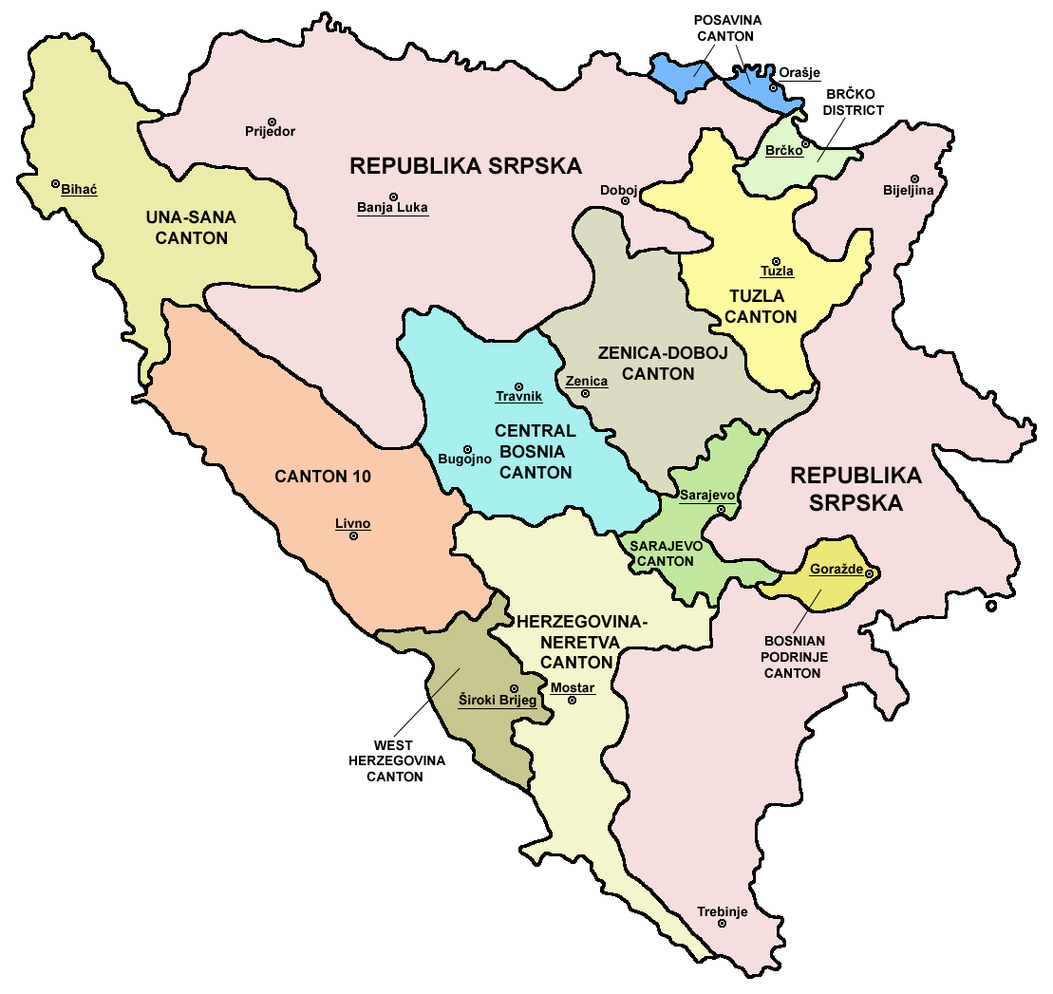
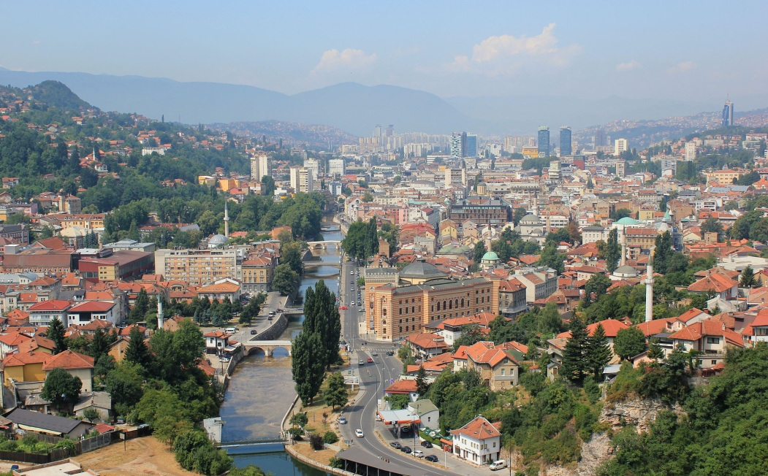

Federation of Bosnia and Herzegovina
Population –
2,371,603
Area –
26,110 km²
Municipality –
79
Density –
89,1
Capital –
Sarajevo

Slide 3
What is perceived and promoted as "Evidence informed decision-making and HTA" on national level?
Book of rules on introduction of new health technologies in healthcare institutions and private practise as well as procedure of approval for use of health technologies (Official Gazette Federation of BiH no. 70/14),
Based on Healthcare Law, article 130. (Official Gazette Federation of BiH no. 46/10 and 75/13).

Slide 4
Book of rules (article 5.)
Final report is document consists of:
  Description of health problem,
  Current use of health technologies,
  Technical characteristics of health technologies,
  Clinical safety and efficacy,
  Costs and economic evaluation and
  Ethical, social, legal and organizational principles.

Slide 5
Book of rules (article 7.)
HTA commission established by Federal Minister of Health consists of seven members:
Medical doctor with academic degree,
Stomatology doctor with academic degree,
Pharmacist with academic degree,
Technical engineer,
Representative from AKAZ,
Representative for Federal Health Insurance Fund,
Representative from Federal Ministry of Health.

Slide 6
Book of rules (article 10.)
HTA commission analyses prepared requests and check are the technical and functional preconditions are met for introducing new in accordance with request.
Health care institutions must not use new health technology without permission for use issued by the Ministry in accordance with this Book of rules.

Slide 7
What actions were taken to improve Evidence based medicine practice?
Agency for Healthcare Quality and Accreditation in FBiH (AKAZ) has mandate to define, validate and disseminate EB clinical practice guidelines for efficient clinical practice.
AKAZ – education and training on EBM and clinical practice guidelines
Medical schools,
International organization,
Professional societies..

Slide 8

Cochrane – what is it? Silvia Minozzi, Cochrane Methods Editor, Cochrane Italia,
Cochrane systematic review – what, how, why? Dario Sambunjak, Cochrane Learning and Support Officer, Croatia,
Setting priorities in clinical research, Mona Nasser, Co-convenor, Cochrane Agenda and Priority Setting Methods Group,
Hayashi's problem: the story of Cochrane systematic review "Neuraminidase inhibitors for preventing and treating influenza in adults and children“. Tom Jefferson, Editor of Acute respiratory infections group (via Skype),
How it all began and what has been achieved? Cochrane Croatia story. Irena Zakarija-Grković , Co-director, Cochrane Croatia.

Slide 9
Cochrane systematic reviews – highest level of evidence. Filipa Markotić, UCH Mostar, Bosnia and Herzegovina,
Cochrane Database of systematic reviews – Practical use in creating essential medicines lists. Mersiha Mahmić-Kaknjo, Cantonal Hospital Zenica, Bosnia and Herzegovina,
Using Cochrane methodology in making a systemic review. Nermin S. Salkić, UCC Tuzla, Bosnia and Herzegovina,
IMPACT (IMProving Access to Clinical Trials data) Observatory: fast-tracking evolution of evidence creation. Karmela Krleža-Jerić, IMPACT Observatory/ NEWFELPRO,
Developing guidelines in Bosnia and Herzegovina. Fadila Serdarević, Medical Faculty University of Sarajevo, BiH
Implementing science into practice, role of the Agency for Quality Improvement. Ahmed Novo, AKAZ BiH.

Slide 10
What are the methods for HTA in the country?
Health technology assessment (HTA) increasingly plays an important role in informing reimbursement and pricing decisions and providing clinical guidance on the use of medical technologies across the world.
In addition to safety and efficacy information, health economic and outcomes research data are also receiving expanded attention in these assessments in many countries, due to payers seeking better value for money spent on treatments.
HTA is now commonly viewed as a tool to assist evidence-based health-care decisions.

Slide 11
Are there any activities related to Evidence informed policy process on national level?
Federal Ministry of Health,
International organization,
UN agencies in Bosnia and Herzegovina.

Slide 12


AKAZ FBiH
Agencija za kvalitet i akreditaciju u zdravstvu u Federaciji Bosne i Hercegovine
Adresa: Dr. Mustafe Pintola 1,
71000 Sarajevo, BiH
Telefon: +387 33 771 870
Fax: +387 33 771 880
URL: www.akaz.ba
Email: akaz@akaz.ba
https://www.facebook.com/#!/akazbih

